Slide 1

Technology Trends Analysis: Programming Languages, Databases, and Developer Insights
KAILASH GOWTHAM U
August 29,2025

Slide 2



OUTLINE
Executive Summary
Introduction
Methodology
Programming Language Trends
Database Trends
Dashboards
Current Technology Usage
Future Technology Trends
Demographics
Insights from Dashboards
Overall Findings & Implications
Conclusion
Appendix

Slide 3

EXECUTIVE SUMMARY
The project analyzes current and future trends in programming languages, databases, platforms, and developer preferences.
Key findings:
JavaScript, TypeScript, and C# dominate current usage.
Developers are eager to learn Python and C#.
PostgreSQL and MySQL are widely used; Microsoft SQL Server and MongoDB are highly desired.
AWS leads platform usage and interest.
Dashboards reveal strong regional and educational diversity among respondents.

Slide 4

INTRODUCTION
The purpose of this report is to analyze current and future technology trends among developers.
The target audience includes tech professionals, aspiring developers, and companies looking to align their technology stack with industry trends.
The report provides insights into what technologies are currently in use and what developers are interested in learning, which is valuable for career planning and business strategy.
The analysis is based on data from a recent developer survey.
The survey provides a comprehensive view of the developer ecosystem.
This information can inform decisions about skill development and recruitment.

Slide 5

METHODOLOGY
Data Sources: IBM Cognos dashboards based on developer survey data.
Collection Method: Responses collected from global developers.
Data Wrangling:
Cleaned categorical responses (e.g., multiple tech selections).
Standardized platforms, languages, and databases.
Filtered top 10 entries for each category.
Analysis:
Comparison between current usage vs. future learning interest.
Trend identification across platforms, languages, and demographics.

Slide 6
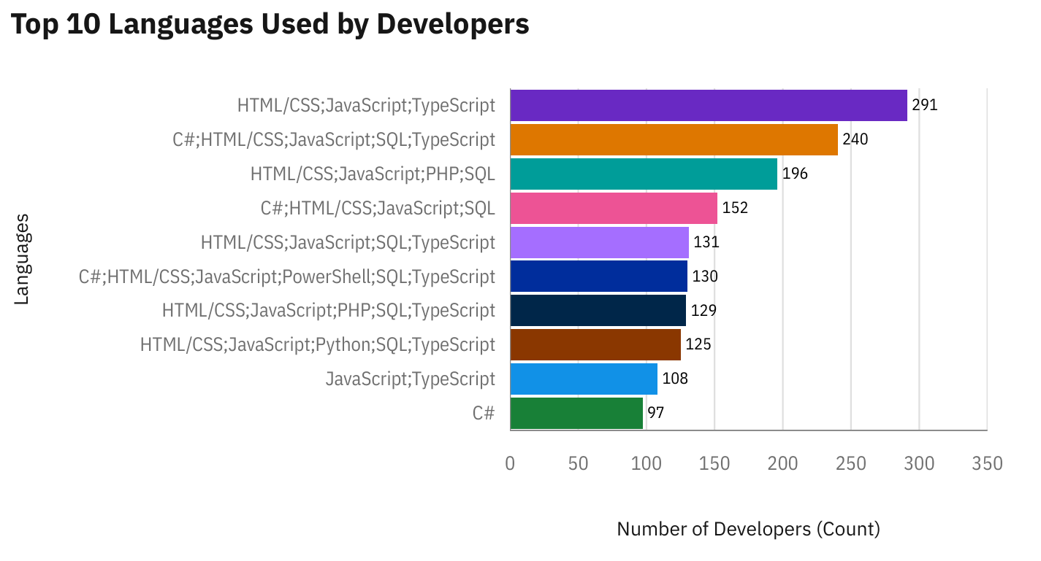
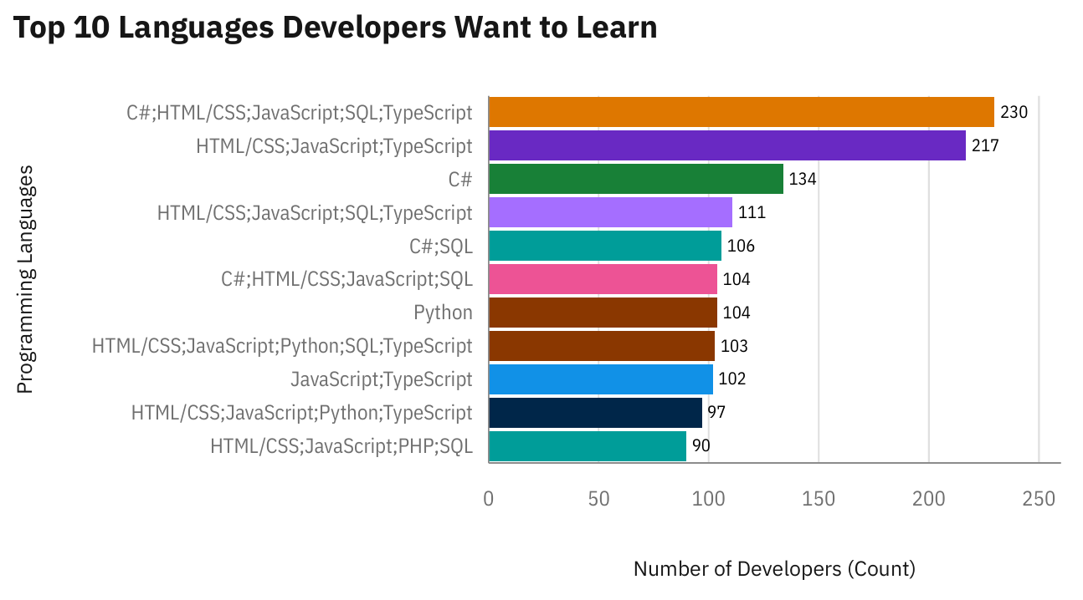
PROGRAMMING LANGUAGE TRENDS
Current Year
Next Year

Slide 7
PROGRAMMING LANGUAGE TRENDS - FINDINGS & IMPLICATIONS
Current Year – Findings
JavaScript, HTML/CSS, and C# are the most widely used languages.
Python has a strong presence, particularly in data science and AI.
TypeScript is gaining steady adoption as a safer, modern alternative to JavaScript.
Current Year – Implications
Web development skills (JavaScript/TypeScript + HTML/CSS) remain essential for most developers.
Enterprises continue to rely on C# for backend and enterprise systems.
Python’s growing share indicates increased demand for data analytics, ML, and AI skills.

Slide 8
PROGRAMMING LANGUAGE TRENDS - FINDINGS & IMPLICATIONS
Future Year – Findings
Developers most want to learn Python, TypeScript, and JavaScript.
C# and SQL remain highly relevant as developers plan to upskill.
Python is the top language in “want to learn,” reflecting interest beyond just current use.
Future Year – Implications
Training programs should prioritize Python and TypeScript for future readiness.
Growth in TypeScript learning signals a shift toward modern front-end frameworks.
Developers preparing for data + AI roles will continue to drive Python adoption.

Slide 9
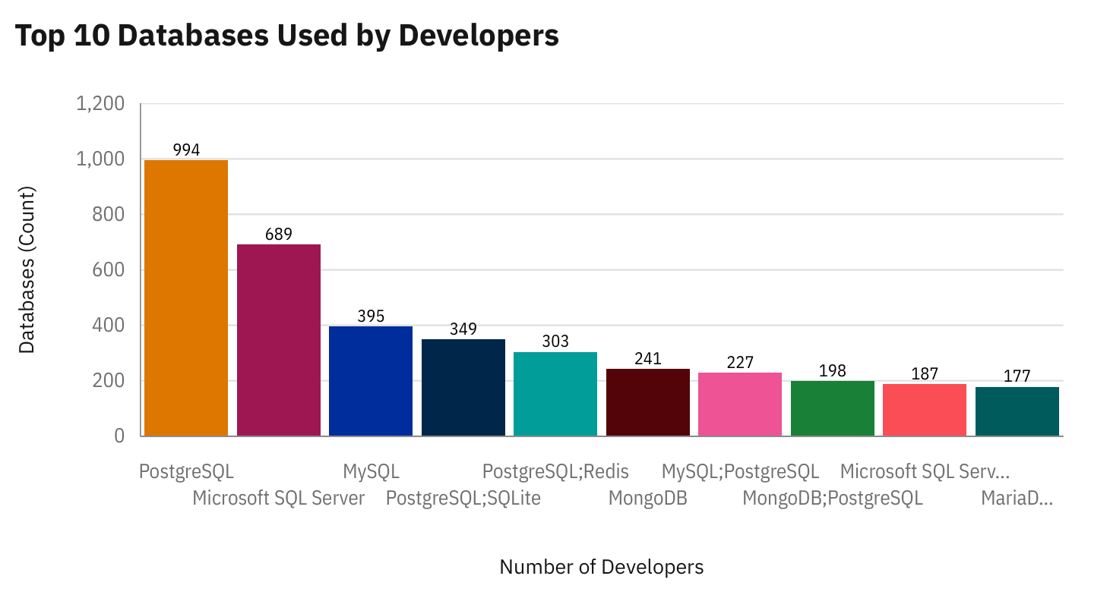
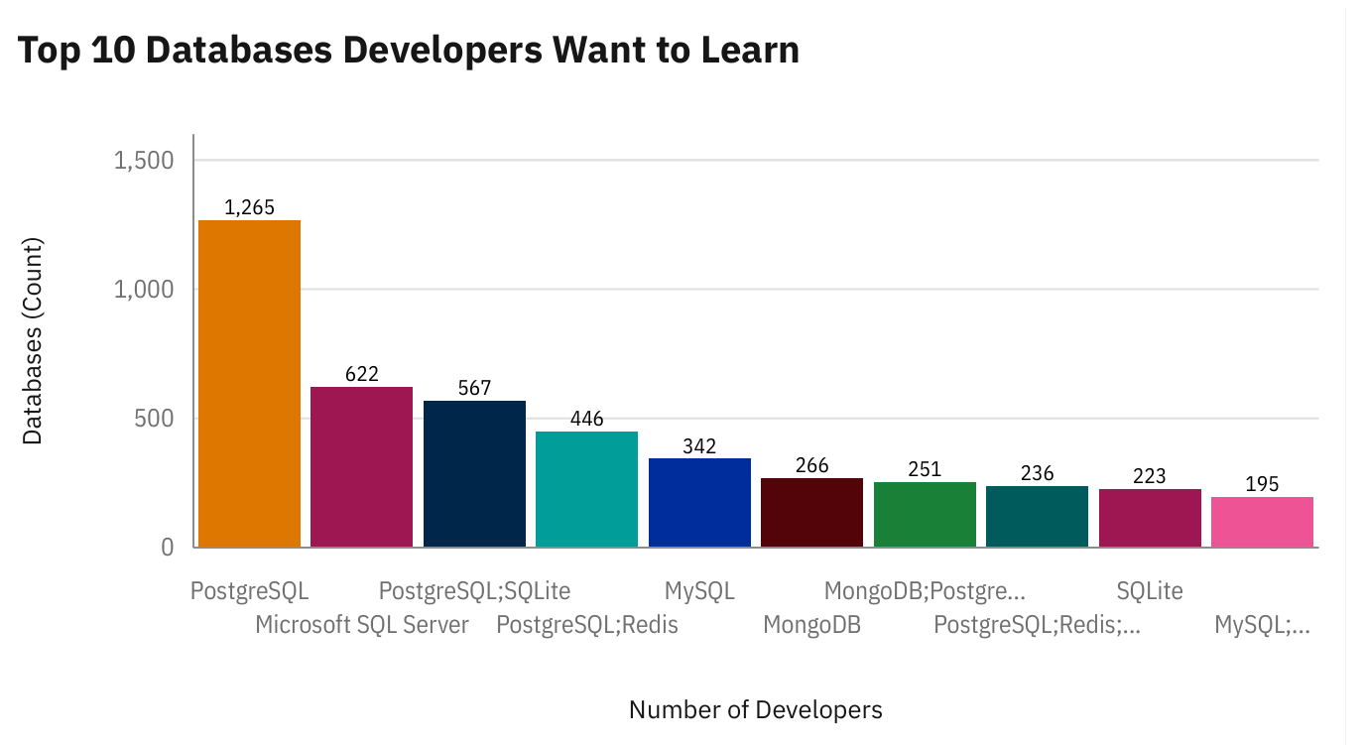
DATABASE TRENDS
Current Year
Next Year

Slide 10
DATABASE TRENDS - FINDINGS & IMPLICATIONS
Current Year – Findings
PostgreSQL, Microsoft SQL Server, and MySQL are the top three databases in use.
NoSQL databases like MongoDB are already gaining significant adoption.
SQLite and Redis appear in niche but important usage categories.
Current Year – Implications
Organizations continue to depend on traditional relational databases for mission-critical apps.
PostgreSQL stands out as the most popular open-source choice.
MongoDB adoption indicates rising interest in flexible, document-based systems.

Slide 11
DATABASE TRENDS - FINDINGS & IMPLICATIONS
Future Year – Findings
PostgreSQL is the most desired database to learn, followed by Microsoft SQL Server and MongoDB.
MongoDB ranks higher in future demand compared to its current adoption.
Developers are also interested in learning SQLite and Redis, suggesting growth in lightweight and high-performance DBs.
Future Year – Implications
PostgreSQL will remain a cornerstone for modern applications due to scalability and open-source benefits.
MongoDB’s future demand shows a clear trend toward NoSQL and big-data-ready platforms.
Developers are preparing for a hybrid future where both relational and NoSQL databases coexist.

Slide 12

DASHBOARD OVERVIEW
The following dashboards highlight
Current Technology Usage,
Future Technology Trend, and
Demographics insights based on survey data.

Slide 13
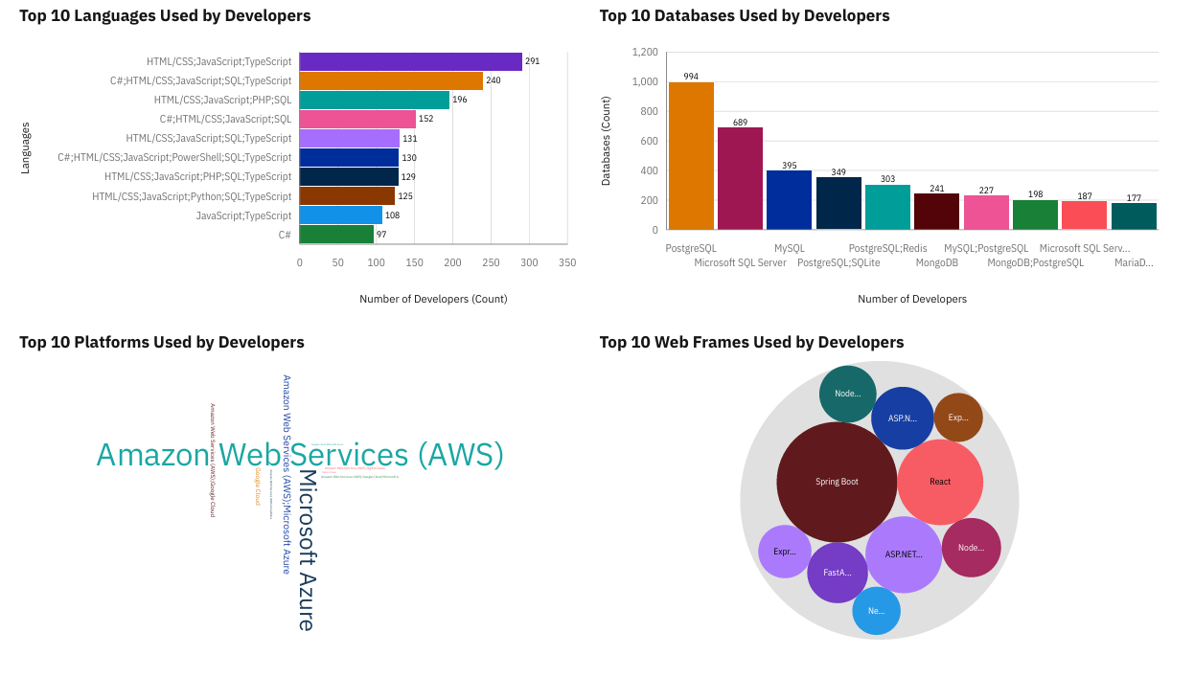
DASHBOARD TAB 1 (Current Technology Usage)

Slide 14
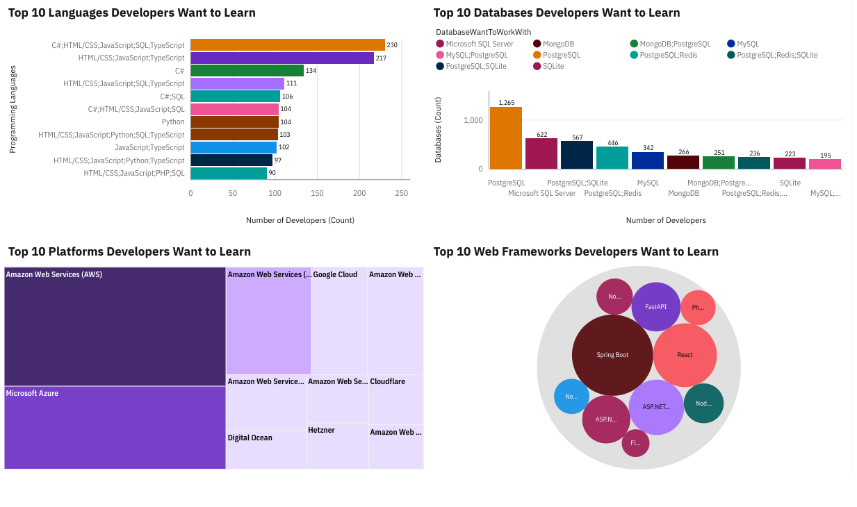
DASHBOARD TAB 2 (Future Technology Trend)

Slide 15
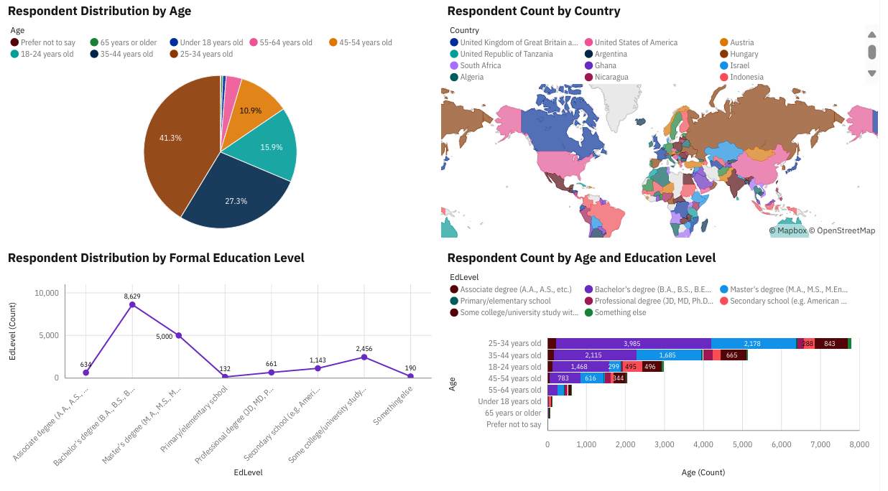
DASHBOARD TAB 3 (Demographics)

Slide 16
DISCUSSION
The Current Technology Usage dashboard shows that the top languages, databases, and platforms used today are HTML/CSS; JavaScript; SQL; TypeScript, PostgreSQL, and Amazon Web Services (AWS) respectively.
The Future Technology Trends dashboard indicates that developers want to learn PostgreSQL and Python, showing a strong interest in these technologies.
The Demographics dashboard reveals that the largest group of respondents are between 25-34 years old (41.3%) and have a Bachelor's degree (8,629 respondents).

Slide 17
OVERALL FINDINGS & IMPLICATIONS
Findings:
Finding 1:
PostgreSQL and AWS are the leading technologies in the database and platform categories, respectively.
Finding 2:
There is a notable desire to learn Python, suggesting its increasing market presence and demand.
Finding 3:
The majority of respondents are experienced developers (age 25-44) with at least a Bachelor's degree, which provides credibility to the survey data.
Implications:
Implication 1:
Businesses should consider adopting a tech stack centered around PostgreSQL and AWS to align with current trends and talent availability.
Implication 2:
Educational institutions and individuals should focus on Python, as it is a highly sought-after skill for future job prospects.
Implication 3:
The findings confirm the value of formal education in the developer community, with a Bachelor's degree being the most common educational background.

Slide 18

CONCLUSION
JavaScript, Python, and TypeScript form the core of future programming trends.
PostgreSQL and MongoDB will drive database innovation.
Cloud platforms (AWS, Azure) remain essential in enterprise adoption.
Developers are young, educated, and eager to adopt emerging technologies.
Insights guide career planning, hiring strategies, and curriculum development.

Slide 19
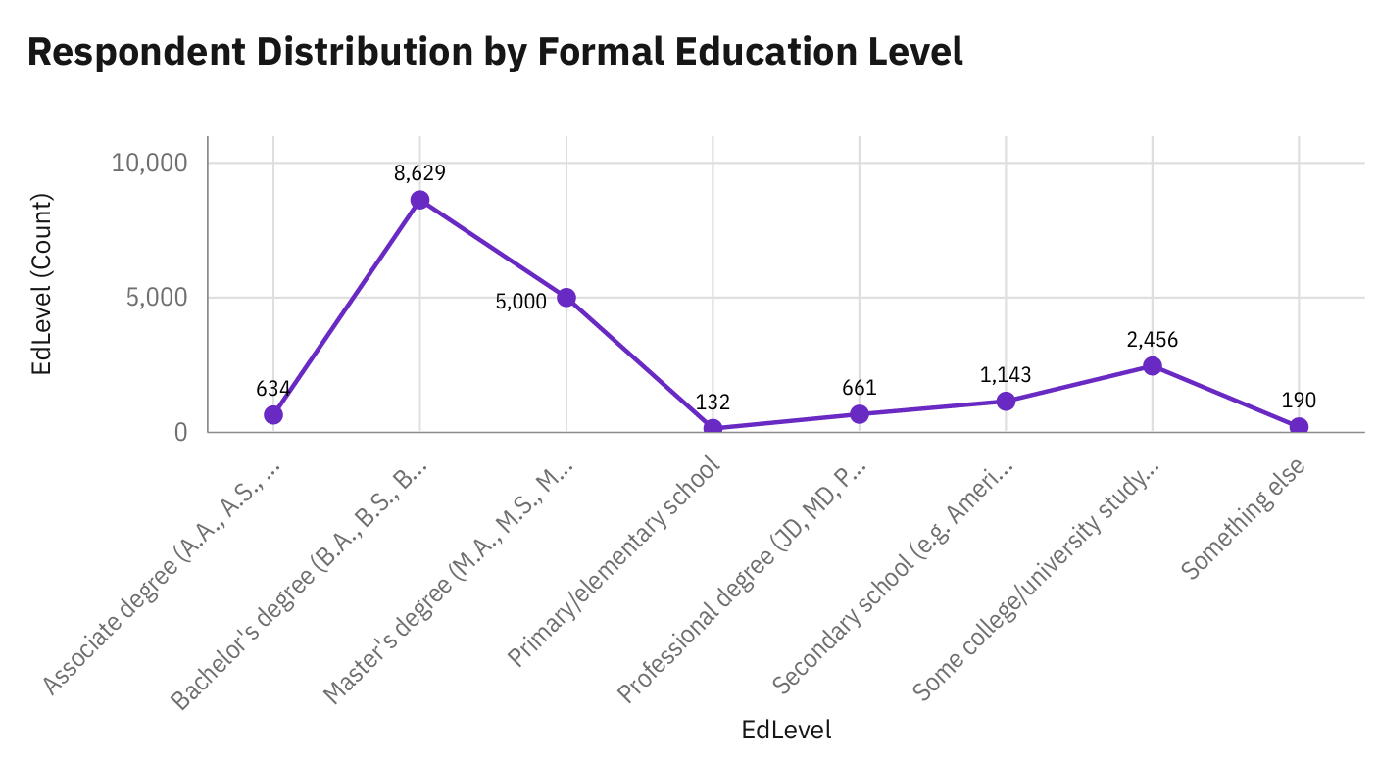

APPENDIX
The majority of respondents are experienced developers (age 25-44) with at least a Bachelor's degree

Slide 20
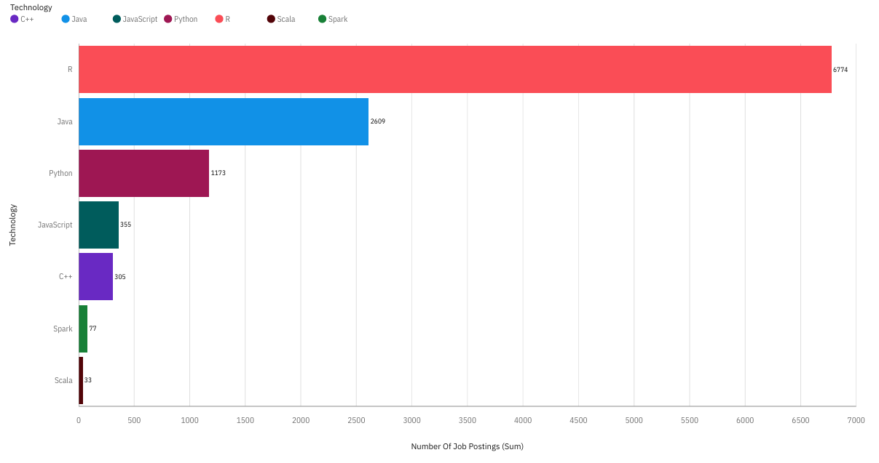
JOB POSTINGS

Slide 21
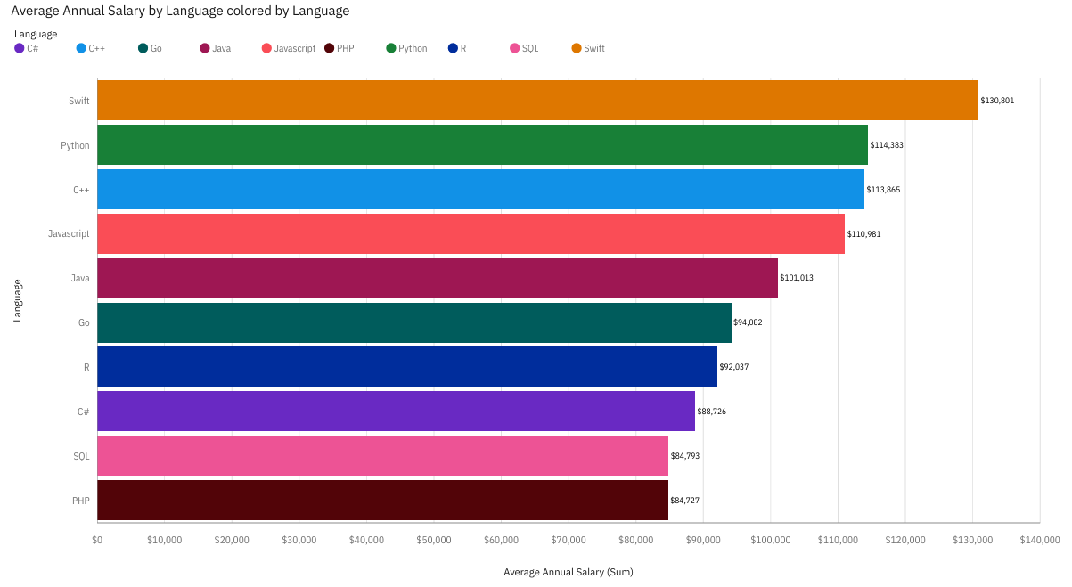
POPULAR LANGUAGES

